Slide 1
Objectives
In this session, you will learn to:
  Validate user input using controls and events
Notes:
Start the session by sharing the session objectives with the students.

Slide 2

Validating Users Input Using Controls and Events
How can we assure that the data entered by a user is correct?

Slide 3

Validating Users Input Using Controls and Events (Contd.)
Validation is performed to assure correctness of the data entered by a user.

Slide 4
Validating Users Input Using Controls and Events (Contd.)
Validation means to check the correctness of the data entered in an application.
By performing validation, the user is prompted to enter correct data. This reduces errors.
Notes:
The faculty must explain to the students that validation is a very important and useful feature that can be added in Windows Form. Validation helps to ensure that the data entered by the users is accurate and as desired.
Let us understand the concept of Validation with the help of an example. While entering student’s marks, the faculty must ensure that the marks entered within the text box are in the range 0-100. Also, the code should ensure that the faculty is restricted from entering text or special characters in the marks text box. If a faculty enters a value such as -5, 113, or ab!, it will be considered as invalid and it should not be allowed also. Therefore, code can be written to ensure that the faculty enters data only within the specified range.
The faculty must prepare and present a demo to show that the data within the controls can be validated. Again you can take the simple example of an addition form. In this form if the user enters text or special characters in place of number, then an error should be raised.

Slide 5
Validation of User Inputs
To validate data in a control, the Validating event of that control can be used.
After performing validation, the user can be prompted by an appropriate message.
Notes:
The faculty must explain to the students that validation is a very important and useful feature that can be added in Windows Form. Validation helps to ensure that the data entered by the users is accurate and as desired.
Let us understand the concept of Validation with the help of an example. While entering student’s marks, the faculty must ensure that the marks entered within the text box are in the range 0-100. Also, the code should ensure that the faculty is restricted from entering text or special characters in the marks text box. If a faculty enters a value such as -5, 113, or ab!, it will be considered as invalid and it should not be allowed also. Therefore, code can be written to ensure that the faculty enters data only within the specified range.
The faculty must prepare and present a demo to show that the data within the controls can be validated. Again you can take the simple example of an addition form. In this form if the user enters text or special characters in place of number, then an error should be raised.

Slide 6
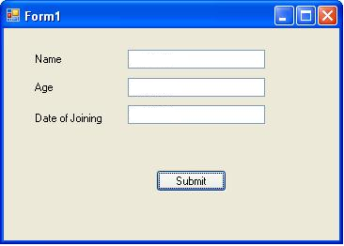
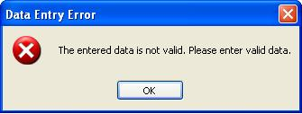
Validation of User Inputs (Contd.)
The following figure shows a form that accepts an input from the user.
If a user enters incorrect data then a message box is displayed that prompts the user to enter a valid data.
Notes:
The faculty must explain to the students that validation is a very important and useful feature that can be added in Windows Form. Validation helps to ensure that the data entered by the users is accurate and as desired.
Let us understand the concept of Validation with the help of an example. While entering student’s marks, the faculty must ensure that the marks entered within the text box are in the range 0-100. Also, the code should ensure that the faculty is restricted from entering text or special characters in the marks text box. If a faculty enters a value such as -5, 113, or ab!, it will be considered as invalid and it should not be allowed also. Therefore, code can be written to ensure that the faculty enters data only within the specified range.
The faculty must prepare and present a demo to show that the data within the controls can be validated. Again you can take the simple example of an addition form. In this form if the user enters text or special characters in place of number, then an error should be raised.

Slide 7
Just a minute
Name the event that enables the user to prevent shifting of focus from a control until all the validation rules have been met.
Answer:
  The Validating event
Notes:
Reiterate the concepts taught earlier by asking the given question.

Slide 8
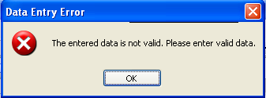
The MessageBox Class
The MessageBox class is used to display informative messages to users.
The following code snippet displays a message box: MessageBox.Show("The entered data is not valid. Please enter valid data.", "Data Entry Error", MessageBoxButtons.OK, MessageBoxIcon.Error);
Message
Notes:
Using the slide 4th, 5th 6^{th,} and 7th, discuss with the students that while validating data, it is essential that proper messages should be displayed in order to specify that the user has entered invalid data. These messages can be displayed using MessageBox class.
Discuss the Show() method of this class that is actually used to display messages. Discuss the parameters that can be used with this method to customize the appearance of the box that appears.
You can also display a small example that shows the use of MessageBox.

Slide 9
The MessageBox Class (Contd.)
The MessageBox class is used to display informative messages to users.
The following code snippet displays a message box: MessageBox.Show("The entered data is not valid. Please enter valid data.", "Data Entry Error", MessageBoxButtons.OK, MessageBoxIcon.Error);
Message Box Title
Notes:
Using the slide 4th, 5th 6^{th,} and 7th, discuss with the students that while validating data, it is essential that proper messages should be displayed in order to specify that the user has entered invalid data. These messages can be displayed using MessageBox class.
Discuss the Show() method of this class that is actually used to display messages. Discuss the parameters that can be used with this method to customize the appearance of the box that appears.
You can also display a small example that shows the use of MessageBox.

Slide 10
The MessageBox Class (Contd.)
The MessageBox class is used to display informative messages to users.
The following code snippet displays a message box: MessageBox.Show("The entered data is not valid. Please enter valid data.", "Data Entry Error", MessageBoxButtons.OK, MessageBoxIcon.Error);
Button
Notes:
Using the slide 4th, 5th 6^{th,} and 7th, discuss with the students that while validating data, it is essential that proper messages should be displayed in order to specify that the user has entered invalid data. These messages can be displayed using MessageBox class.
Discuss the Show() method of this class that is actually used to display messages. Discuss the parameters that can be used with this method to customize the appearance of the box that appears.
You can also display a small example that shows the use of MessageBox.

Slide 11
The MessageBox Class (Contd.)
The MessageBox class is used to display informative messages to users.
The following code snippet displays a message box: MessageBox.Show("The entered data is not valid. Please enter valid data.", "Data Entry Error", MessageBoxButtons.OK, MessageBoxIcon.Error);
Icon
Notes:
Using the slide 4th, 5th 6^{th,} and 7th, discuss with the students that while validating data, it is essential that proper messages should be displayed in order to specify that the user has entered invalid data. These messages can be displayed using MessageBox class.
Discuss the Show() method of this class that is actually used to display messages. Discuss the parameters that can be used with this method to customize the appearance of the box that appears.
You can also display a small example that shows the use of MessageBox.

Slide 12
Just a minute
How many parameters are there in the Show() method of the MessageBox class?
  1. One
  2. Two
  3. Three
  4. Four
Answer:
  4. Four
Notes:
Reiterate the concepts taught earlier by asking the given question.

Slide 13
Just a minute
Which method of the MessageBox class is used to display a message in the message box?
Answer:
  The Show() method
Notes:
Reiterate the concepts taught earlier by asking the given question.

Slide 14
The StatusStrip Control
The StatusStrip control:
  Is a container control derived from System.Windows.Forms.ToolStrip class.
  Is used to display information about the controls on the current form.
  Is used to provide feedback on the progress of any operation.
  Contains the following child controls:
    StatusLabel
    ProgressBar
    DropDownButton
    SplitButton
Notes:
Using this slide and the next slide, the faculty should discuss the purpose and features of the StatusStrip control. This control should be used to specify messages that can help the user identify the correct data to be entered by the user. In addition, it provides other features also. The faculty must demonstrate an application with this control.

Slide 15
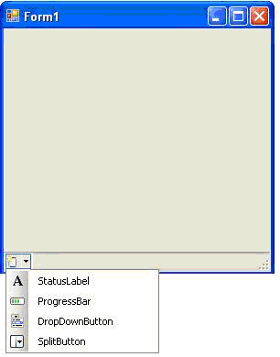
The StatusStrip Control (Contd.)
The following figure shows the StatusStrip control with its child controls.
This control is used to display status information. It is used to prompt the user for a valid entry.
This control is used to show the progress status of any task.
This control displays ToolStripDropDown from which a user can select a single item from many items.
This control is a combination of a standard button on the left and a dropdown button on the right.
Notes:
The faculty must discuss the following properties of the StatusStrip Control:
Items
LayoutStyle
Dock

Slide 16
Just a minute
Which of the following positions is the default docking position of the StatusStrip control on the form?
  1. Left
  2. Right
  3. Top
  4. Bottom
Answer:
  4. Bottom
Notes:
Reiterate the concepts taught earlier by asking the given question.

Slide 17
Just a minute
Which property of the ProgressBar control specifies the amount of increment with which the current value of the control will to changes?
  1. Minimum
  2. Maximum
  3. Value
  4. Step
Answer:
  4. Step
Notes:
Reiterate the concepts taught earlier by asking the given question.

Slide 18
Summary
In this session, you learned that:
  Validation is a means to check the accuracy and the correctness of the data entered by the user.
  The Validating event enables you to prevent the user from shifting the focus from the control being validated to some other control on the form until all validation rules have been met.
  The MessageBox class is used to display messages on the screen.
  An instance of the MessageBox class cannot be created by using the new keyword.
  The StatusStrip control is derived from System.Windows.Forms.ToolStrip class.
  The StatusStrip control is a container control that can hold other controls.
Notes:
You can summarize the session by running through the summary given in SG.
In addition, you can also ask students summarize what they have learnt in this session.

Slide 19
Summary (Contd.)
  The StatusStrip control contains four types of controls. The controls are:
    StatusLabel
    ProgressBar
    DropDownButton
    SplitButton
Notes:
You can summarize the session by running through the summary given in SG.
In addition, you can also ask students summarize what they have learnt in this session.

Slide 20
Home Assignment
Let me give you some questions to solve at home.

